Slide 1



VIRTUAL REALITY
WELDING TRAINING
CODED WELDER: OFO 651202-02
KM-07: SAFELY USE, CARE AND STORE ENGINEERING POWER
TOOLS, NQF LEVEL 2, CREDITS 2 4

Slide 2
ABOUT THIS MODULE
The main focus of this module is understanding the safely use, care and store a range of engineering power tools used for cutting, grinding, drilling and storing of power tools in a safe lock up designated area.
The learning will enable learners to demonstrate an understanding of:
KM-07-KT01: Safely use engineering power tools. (60%)
KM-07-KT02: Apply care and maintenance of engineering power tools. (30%)
KM-07-KT03: Store engineering power tools in a safely designated area (10%

Slide 3
KM-07-KT01: Safely use engineering power tools.
Topic elements to be covered include:
KT0101 Demonstrate safe working practices, apply worksite practice and generic health, safety and environmental protection concepts prior to commencement using of engineering power tools.
KT0102 Identify, select, and safely use power tools as recommended by the manufacturer specifications to meet the task descriptions.
KT0103 Read and interpret the name plate on the power tools to identify the task related specifications.
KT0104 Use the correct consumables as recommended by the manufacturer’s specification.

Slide 4
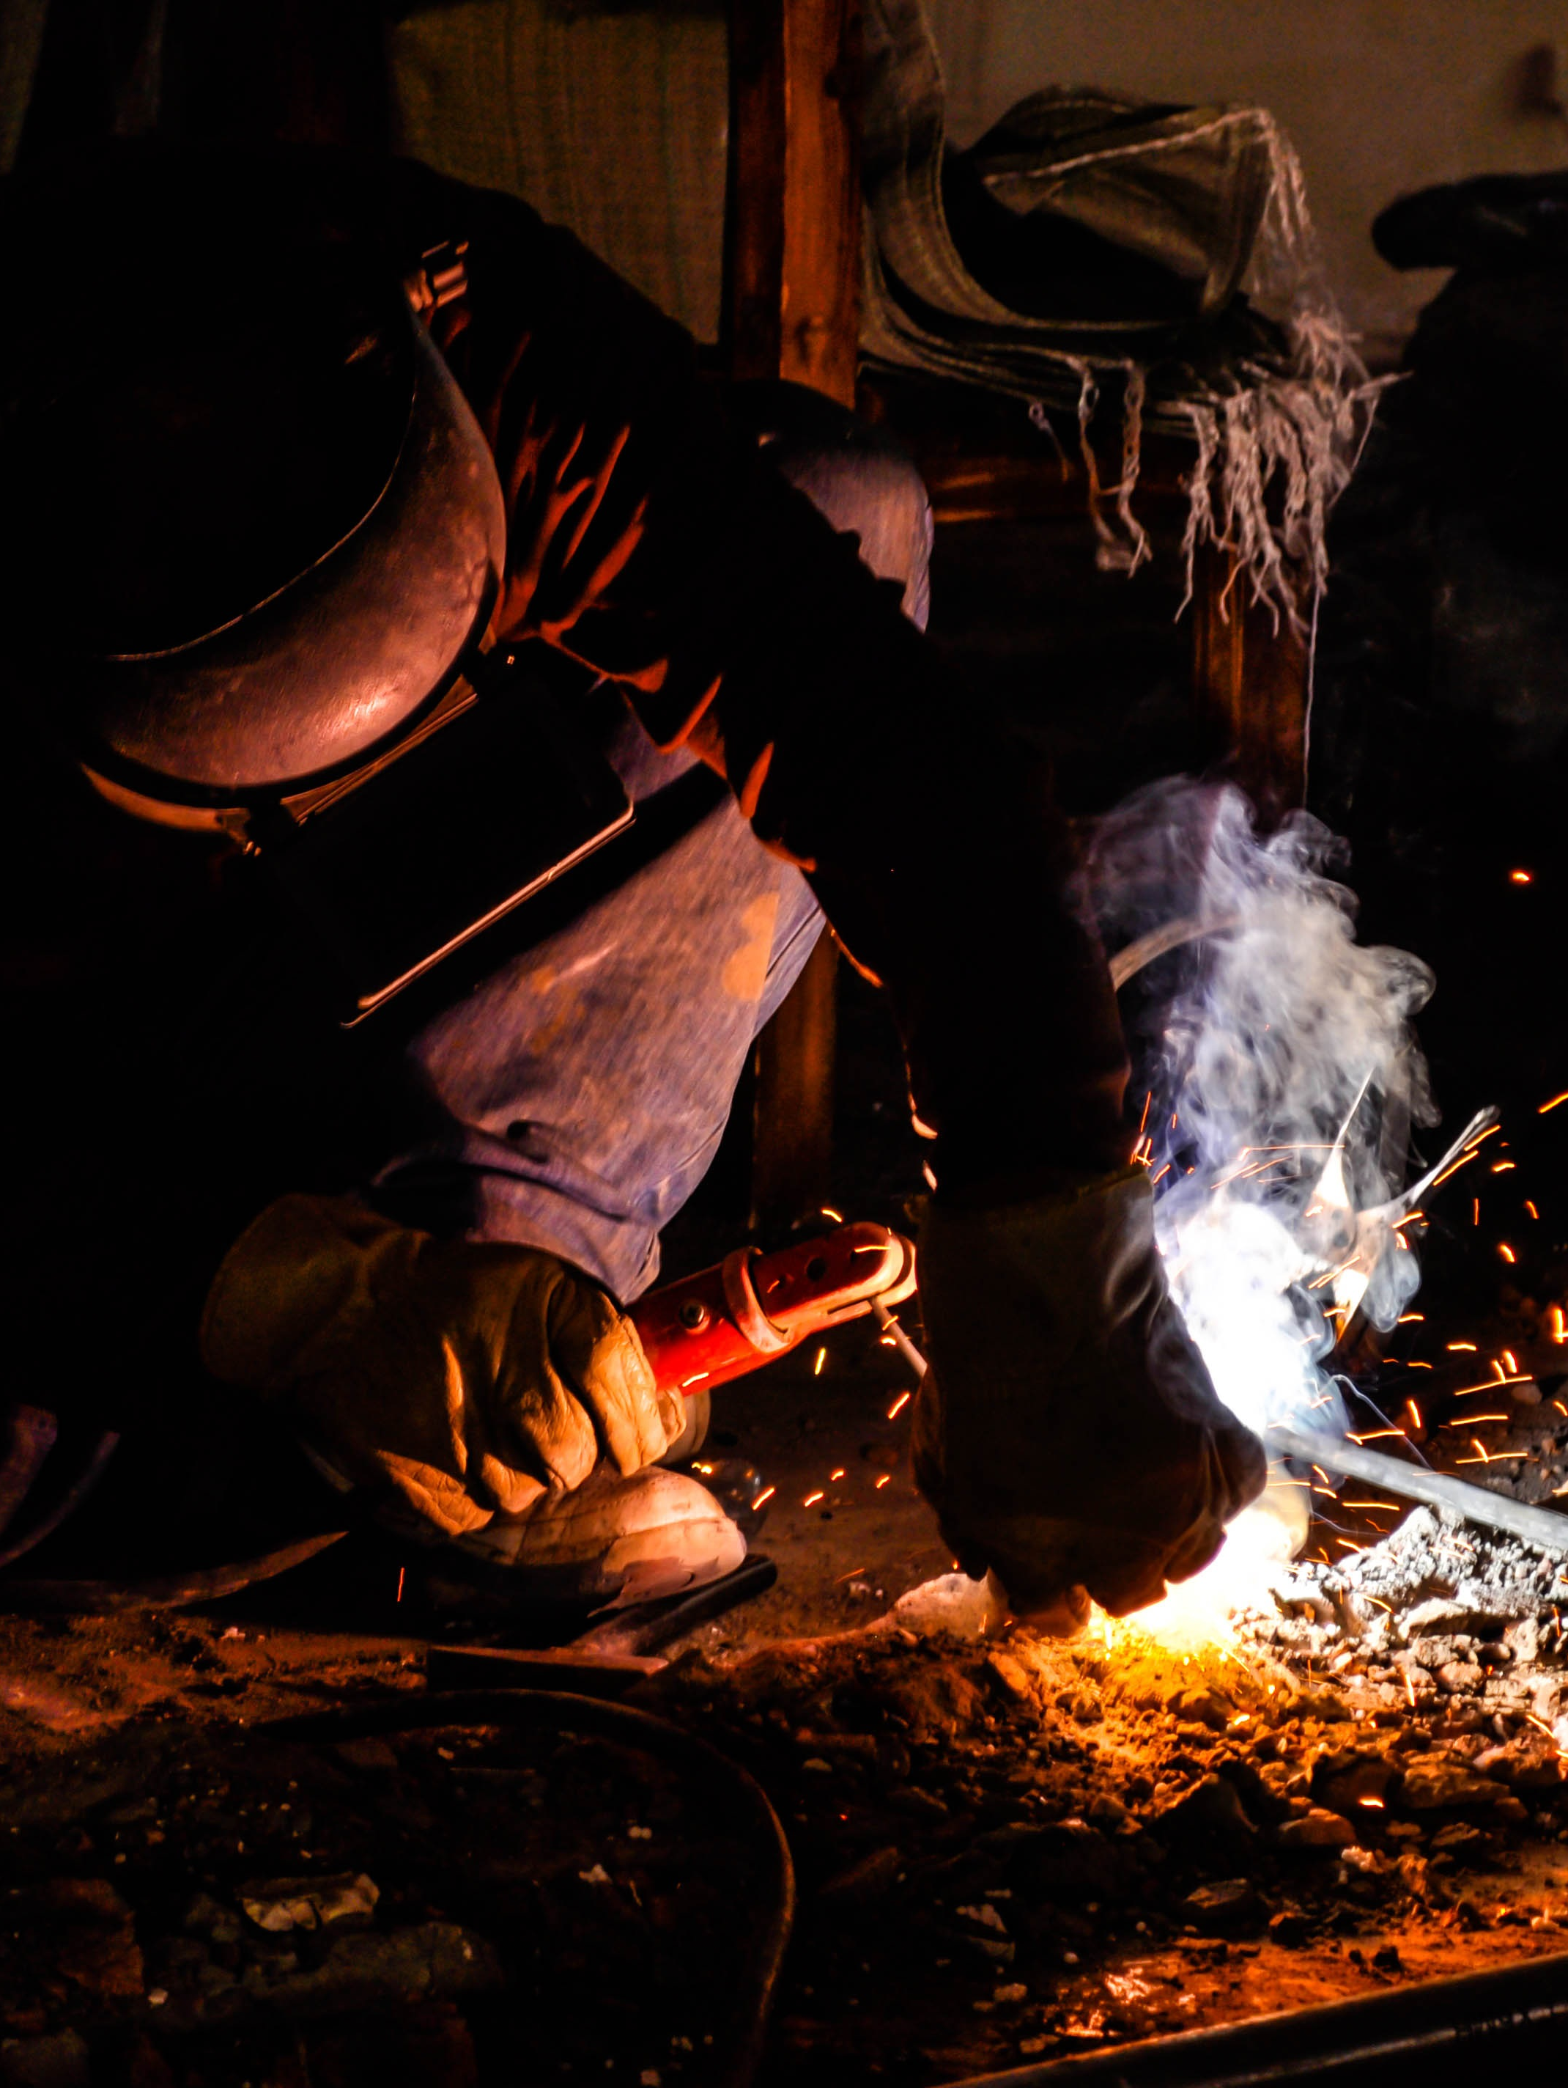
KT0101 Demonstrate safe working practices, apply worksite practice and generic health, safety and environmental protection concepts while using engineering power tools
The power tools and machinery which you are going to use are very dangerous and you must know how to use them properly.
Before you attempt to do any work, make sure that the safety measures specified for each tool and machine.
These safety measures are designed to protect you, your fellow-workers, and the equipment you use.
Revise on the key safety measures to developing safe working habits from the previous module.

Slide 5
Safety measures when using machinery and power tools Each machine has safety measures which you must know. There are the following general rules, though, that you must follow when you work with machinery. .
Be aware of your work area.
Make sure that you know how to operate the machine safely and how to stop the machine in an emergency.
Replace the machine guards before you switch the power on if the guards were removed to repair or adjust the machine.
Always switch of your machine at the isolator switch (plug socket) before changing a tool, grinding disc or wheel.
Keep the floors, passageways and space around machines clear of small objects and machine accessories.
Do not leave a machine unattended while it is operating.
Never oil a machine while it is operating.

Slide 6
1. Regulations for the metal industry
These regulations are taken from the Occupational Safety and Health Act No.85 of 1993 and apply to students from the metal industry.
If you are from the metal industry, you will have to know what these rules mean.
1. Admittance of Persons
Only authorized individuals are allowed in workplaces with machinery.
Safety notices may restrict entry to workshops with machinery without permission.

Slide 7
Regulations for the metal industry (p2)
2. Revolving Machinery
Unless machine components are as safe as they would be if they were securely fenced or guarded, the user shall:
(a) Securely fence or guard shafts, pulleys, wheels, gears, , sprocket, coupling, collar, clutch, friction drum or similar objects .
(b) Ensure set screws, keys, or bolts on moving parts are countersunk or guarded.

Slide 8
Regulations for the metal industry (p3)
3. Safeguarding of Machinery
Every employer or user of machinery shall-
(a) Ensure machinery is suitable, installed, operated, and maintained to prevent exposure to hazards.
(b) Safeguard exposed and dangerous parts within reach, unless inspector permits omission.
(c) Keep safety equipment in good working condition and ensure proper use.
(d) Ensure quality material and construction of machinery and safety equipment are suitable for their intended purpose.
Enclose and lock premises if machinery poses a danger.
Do not remove safety equipment without authorization from the employer or machinery user.

Slide 9
Regulations for the metal industry (p4)
4. Operation of Machinery
Ensure machinery operators are aware of dangers and safety measures.
Operators of machinery requiring constant attention must not leave their posts during operation.
Machinery needing constant attention should be supervised by a shifts man, present during operation.
No one can authorize another person's work without permission.
Take precautions to prevent unexpected motion or electrical activation of machinery.
Stop machinery if it threatens the safety of supervisors or operators.

Slide 10
Regulations for the metal industry (p5)
5. Devices to start and stop machinery
Employer must provide easily reachable start and stop devices for machinery and they must be:
Be in a position where they can readily and conveniently be reached
Constructed and arranged accordingly to prevent accidental starting
Ensure machinery controls driven by an electric motor can be rendered inoperative during repairs, not just by tripping a switch.
If machinery is operated by multiple persons, provide a stopping device at each operation point and an audible warning before motion. Alternative measures may be approved by an inspector for safety.

Slide 11
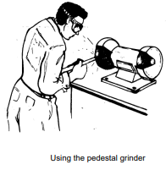
2. Using Grinding wheels
The responsibility of the user includes:
1. Display the spindle's revolutions per minute (rpm) prominently on the grinding machine.
2. Use grinding wheels only if the manufacturer's rated maximum speed is clearly marked.
3. Ensure the spindle speed aligns with the manufacturer's specified maximum speed on the wheel.
4. Do not use damaged or improperly dressed grinding wheels.
5. Mount the grinding wheel concentrically on the spindle between two sturdy flanges, with flange diameter one-third of the wheel.
6. Place a compressible material or paper washer between the wheel and flange to prevent metal contact during motion.
7. Equip all grinding machines with robust guards capable of withstanding wheel breakage.
8. Provide grinding machines with a tool rest, maintaining a maximum distance of 3 mm from the wheel or working face.
9. Wear goggles if grinding machines lack a protective transparent shield,

Slide 12
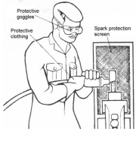
3. Safe use of power operated grinders
(a) Before grinding ensure that the tools are in a safe condition
(b) Inspect the stone carefully, as any fault is dangerous. Change the grinding wheel or stone – if necessary:
Unevenly worn wheel
Wheel not running true
Chipped or cracked wheel
(c) Wear protective clothing
(d) Place screens to protect others from sparks
(e) Before starting grinder, hold firmly to prevent torque twisting grinder out of grip

Slide 13
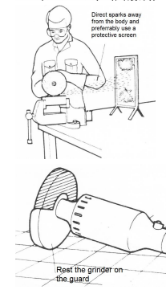
3. Safe use of power operated grinders (p2)
(f) While stone is in contact with work, use constant pressure but avoid slowing motor with too much pressure. Hold so that the sparks fly away from the body.
(g) Do not put grinder down while the disc or stone still revolving. Hold until the disc or stone is stationary, then place down gently so that the disc or stone is not in contact with the workbench
(h) Unplug the grinder as soon as possible because it is a potential danger while it is still plugged in

Slide 14
Assessment Activity
Choose the correct answer:
1. It is safe to leave pieces of material:
(a) On the machine shop floor
(b) In a rubbish bin
(c) In a storeroom; or
(d) On your workbench.
2. We must replace machine guards.
(a) Every week.
(b) After repairing the machine.
(c) While the machine is operating; or
(d) When we clean the workshop.
3. Make sure that your work piece is properly secured in the machine so that.
(a) You can do proper measurements as you work.
(b) You can work accurately.
(c) Your work piece is neatly finished off; or
(d) It does not come loose and cause an accident.

Slide 15
Assessment Activity (p2)
Answer the following questions:
State three reasons for wearing gloves in a machine shop.
Why does oil or grease on the shop floor create a safety hazard? Give three reasons.
Why do we not leave hand tools on machines?
Regulation 3.12 deals with disobedience. What does is state?
Regulation 4.4.1 states that a complaint book must be supplied. State:
(a) Where the complaint book must be kept.
(b) What kind of complaints you can enter; and
(c) Who must inspect this book and how often?
Regulation 5.8.1 discusses lifelines. State when, or under what conditions, a person must be secured by a lifeline.
Regulation 5.8.3 deals with hard hats. When or where must you wear a hard hat?
Regulation 10.2.4 discusses the use of compressed air. What can you not use compressed air for?

Slide 16
KT0102 Identified, select, and safely use for all related engineering power tools.
The types of power tools covered in this learner guide include the following:
1. Drilling machines
1.1. Sensitive drilling machine
1.2. Column drilling machine
1.3. Radial drilling machine
2. Pedestal grinder
3. Portable power tools
3.1. Portable drilling machine
3.2. Jigsaw
3.3. Angle grinder
4. Pneumatic power tools
4.1. Pneumatic drilling machine
4.2. Pneumatic angle grinder
4.3. Pneumatic impact wrench

Slide 17
1. Drilling machine- the pedestal drilling machine
Used to carry out precision drilling tasks and is probably the most commonly used machine in the workshop.
Before you operate a pedestal-drilling machine, you must be able to identify the different types of pedestal drilling machines and their components.
Types of pedestal drilling machines include:
Sensitive drilling machine.
Column drilling machine.
Radial drilling machine

Slide 18
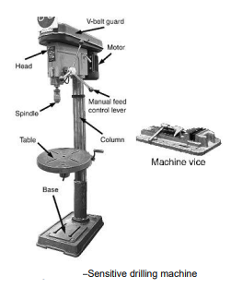
1. Drilling machine- the pedestal drilling machine (p2)
Sensitive drilling machine
- The sensitive drilling machine (as the name implies) is a machine for light drilling work. It is manually operated and driven by V-belts, not through a gearbox.

Slide 19
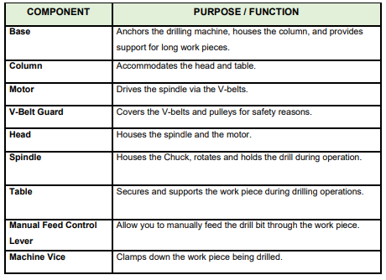
Components of a sensitive drilling machine

Slide 20
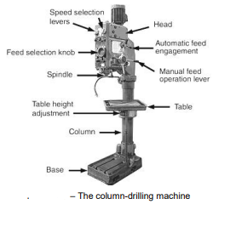
(b) Column drilling machine
The column-drilling machine is like the sensitive drilling machine except that it is more robust and stronger. It is driven from a gearbox and feedbox.

Slide 21
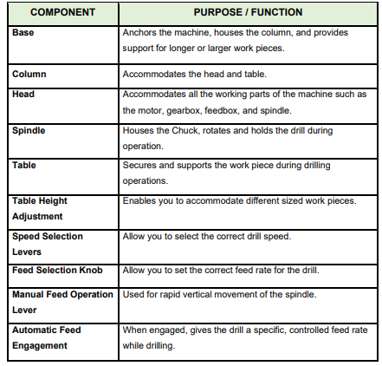
Components of Column-Drilling Machine

Slide 22
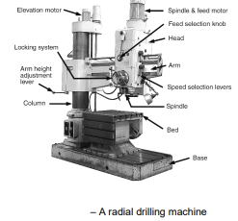
(c) Radial drilling machine
The radial drilling machine is specifically designed for heavy drilling tasks. It has both radial and horizontal movement, so that the drill can be centered over the point where the hole is to be drilled.

Slide 23
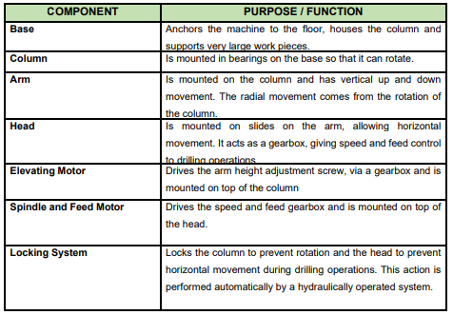
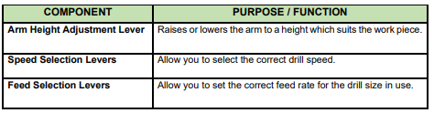
Components of the Radial Drilling Machine

Slide 24
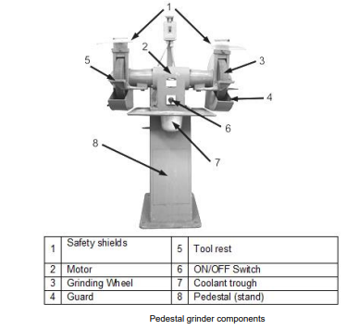
(d) The pedestal grinder
It is a machine mounted on a raised stand. It consists of an abrasive wheel for tasks like sharpening and shaping materials. Users stand in front of the machine for precision grinding.

Slide 25
The pedestal grinder(p2)
Safety aspects and standards
The standing area must be free from any lubricant or loose material that may cause you to slip or trip.
Your hands must be clean and free from oil or grease.
You must not wear loose clothing near the machine while it is operating.
You must wear closed safety glasses while grinding.
When you start up the grinder, you must stand clear (away) from the rotating stones, until the machine has reached full speed.
The gap between the stone and the tool rest must not be more than 3mm.
The stone must not be damaged or have any materials clinging to it.
The ‘face’ of the stone must always be straight (square).

Slide 26
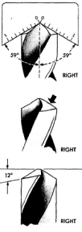
The pedestal grinder (p3)
Sharpening twist drills
Twist drills may be ground in a drill holder fixture or free hand.
Use fixture if available. Both methods are given in the following pages.
Grind drill lips or cutting edges at a 59-degree angle for general use (50-60 degrees for brass or bronze, 68 degrees for extremely hard materials).
Ensure both cutting edges have the same angle with the drill axis and are of equal length.
Grind heel to an angle of 12 to 15 degrees (9 degrees for drilling extremely hard material), Failure to provide sufficient clearance is the principal cause of drills splitting up the web.

Slide 27
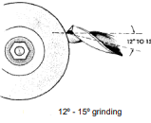
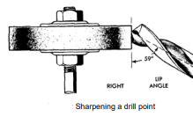
The pedestal grinder(p4)
Sharpening twist drills – cont…
Adjust the drill grinding machine to the desired cutting edge and heel angles, referring to illustrations for lip and heel angles.
Place the drill in the V-blocks of the holder, ensuring the cutting edge contacts the abrasive wheel as the drill is fed into it.
Start the motor and advance the tailstock until the drill contacts the wheel.
Hold the drill in place in V-blocks and slowly swing the holder spindle through its arc.
Without changing the tailstock adjustment, revolve the drill one-half turn in V-blocks and sharpen the other lip in the same manner..

Slide 28
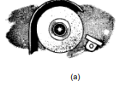
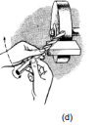
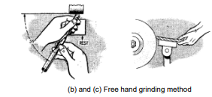
(e) Free Hand Grinding
Adjust tool rest to a convenient height for resting back of forehand on it while grinding
Hold drill between thumb and index finger of right or left hand. Grasp body of drill near shank with other hand.
Place forehand on drill rest with centreline of drill making desired angle with cutting face of wheel and slightly lower shank end of drill as illustrated.

Slide 29
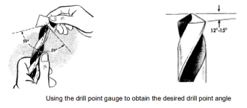
Free Hand Grinding (p2)
Position drill heel against grinding wheel, gradually lift shank, and twist counterclockwise. Apply light pressure, cooling in water as needed.
Verify results with a gauge for equal cutting-edge length and desired angles. Check heel angle of 12 to 15 degrees.

Slide 30
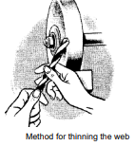
(f) Thinning Web
To strengthen a drill, the thickness of web is increased as flute approaches shank. As point is ground back, the web becomes thicker.
Ordinarily a web at the point of greater than 1/32 to 1/16 of an inch is objectionable.
Grind down web on a thin round or bevel edge wheel to obtain web thickness of a new drill of same size.
Use care to remove the same amount of metal from each flute. A coarse hand stone may be used to obtain the dimension when a grinding wheel of the proper width is not available.
Hold drill flat on bench and stroke flute away from point. Use care to keep from stoning away drill land

Slide 31
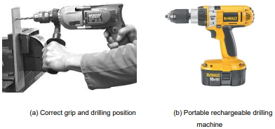
2. Portable power tools
(a) Drilling machine
Electric drilling machines are the most common drilling machines in use today.
They are hand-operated drilling machines which can be worked from any mains plug of a suitable voltage example, 220V AC.
The drill spindle is driven by an electric motor driving through a reduction gear train.
Current technology advances are making the portable rechargeable drilling machine

Slide 32
Portable power tools (p2)
Portable electrical drilling machines have the following features:
Hammer action.
Electronic variable speed selection. •
Automatic safety clutch.
Keyless chuck.
Battery driven.
Forward and reverse action

Slide 33
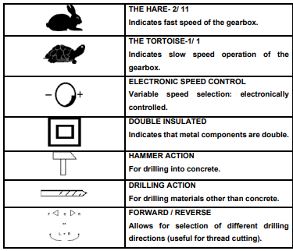
Portable power tools (p3)
Identification of symbols for drilling machine

Slide 34
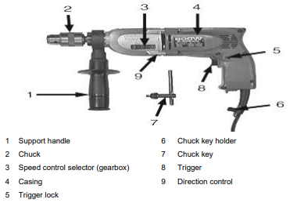
Portable power tools (p4)
Identification of components for drilling machine

Slide 35
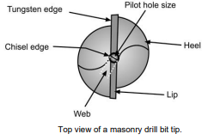
(b) Drill Bits
Can be used on metal, concrete, metals and wood.
Masonry drill bits are the only drill bits to be used on concrete and bricks as they have tungsten tips:
Speed setting is medium to slow, depending on the drill bit size.
Select hammer action on drilling machine.
No lubricant is necessary.

Slide 36
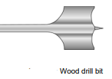
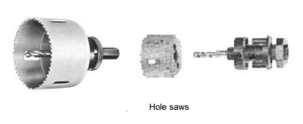
(b) Drill Bits (p2)
Can be used on metal, concrete, metals and wood.
Speed settings is fast to medium, depending on the drill bit size.
No lubricant is necessary.
Hole Saws
These are used for large holes in thin steel plates (1 – 5mm) or on other materials such as wood, plastic or Perspex.
Speed settings for hole saws is slow.
Use cutting paste when drilling steel. Other materials do not need lubricants.

Slide 37
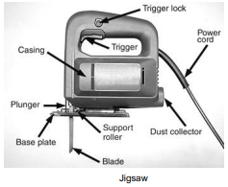
(c) Jigsaw
Used to cut curves out of various materials. To do this with hand tools takes a lot of time and effort.
When you have mastered the handling of a jigsaw, precision curve cutting is time saving, safe, and requires minimum effort.

Slide 38
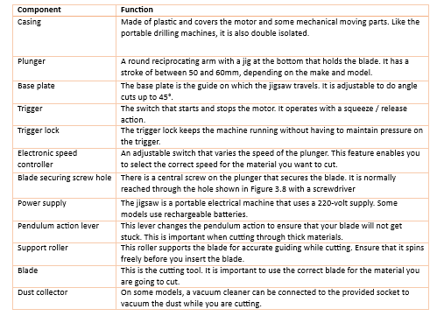
Jigsaw (p2)
Jigsaw Components

Slide 39
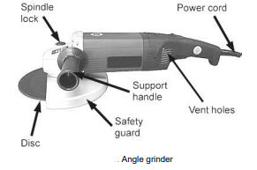
(d) Angle grinder
An angle grinder is a handheld power tool used for cutting, grinding, and polishing a variety of materials, such as metal, stone, or wood.
Hand tools, such as hacksaws, chisels and files take much more time and effort when used for the same task. Angle grinders run at a high speed (± 6 000 rpm), making it one of the most dangerous yet effective electric power tools.

Slide 40
Angle grinder (p2)
Components of an angle grinder include:
Casing: Divided into metal front (gearbox housing) and plastic rear for double insulation and reduced weight.
Support Handle: Plastic, adjustable to three positions on new models for user comfort and safety.
Guard: Steel guard, adjustable, crucial for protecting against flying objects.
Trigger: Starts and stops the motor, includes safety lock to prevent accidental start, and continuous operation lock. New models feature a two-action trigger switch for enhanced safety.
Shaft: Accommodates the disc, with a flat spanner slot on the gearbox end to prevent rotation during disc changes. The other end has threads for securing the disc.

Slide 41
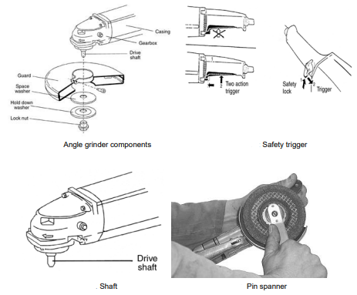
Angle grinder (p3)
Cutting discs
There are two categories of discs, namely,
Cutting – this will be used to cut material.
Grinding - will grind or clean the material

Slide 42
Angle grinder (p4)
Selection of equipment
Welders are always advised to use the appropriate wheel or disc for specific actions like grinding, cutting, or cleaning with an angle grinder.
Safety precautions of using these tools:
Avoid using a concrete cutting disc for grinding steel or a slow-speed disc in a high-speed machine.
Refer to the scope of work for correct disc selection based on the work.
The machine's power, speed, and operator skill impact disc performance.
Discs have specific sizes and are designed for use in particular machines.
Discs with unreadable information should be immediately destroyed and discarded.

Slide 43
(e) Pneumatic power tools
Pneumatic power tools are tools that are powered by compressed air.
These tools use air pressure to perform mechanical work.
Examples of pneumatic power tools commonly used in welding and metalworking include pneumatic grinders, pneumatic drills, and pneumatic hammers.
These tools are known for their versatility, efficiency, and durability in various industrial applications.
Commonly use Pneumatic tools in welding include:
Pneumatic drill
Pneumatic angle grinder
Pneumatic impact wrench

Slide 44
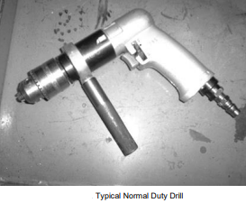
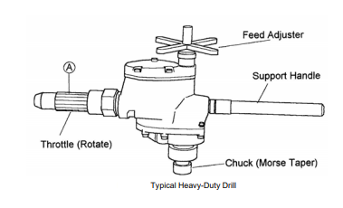
Pneumatic power tools (p2)

Slide 45
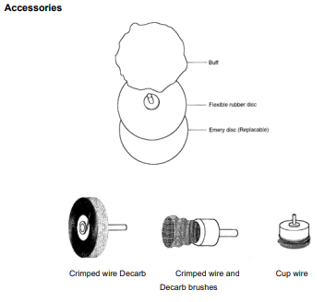
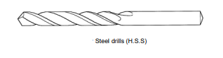
Pneumatic power tools (p3)

Slide 46
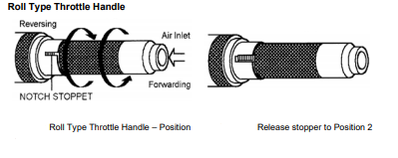
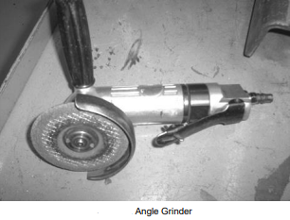
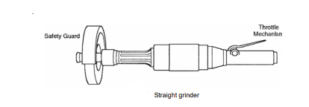
Pneumatic power tools (p4) - Grinders and Throttle

Slide 47
Pneumatic power tools (p5) - Grinders and Throttle Safety Guard
The safety guard protects you from sparks and when the disc accidentally breaks.
Like the electrical grinder, the pneumatic angle grinder is also fitted with a safety guard. This guard must be fitted to the grinder, before the disc is fitted.
Some grinders are provided with a front side- handle. Because the oil outlet is located on the right side of some grinders the front side-handle can only be fitted to the left side.

Slide 48
Pneumatic power tools (p6) - Grinders and Throttle Application
The pneumatic grinder is a safer alternative to the electric one with similar applications due to limited torque.
The straight grinder is designed for material removal on large flat surfaces and internal grinding, not suitable for tasks requiring a high surface finish.

Slide 49
Pneumatic power tools (p6) - Grinders and Throttle safety inspections
• Ensure tool safety before grinding.
• Inspect grinding disc for uneven wear, oval running, and chips or cracks.
• Carefully replace grinder wheels without over-tightening the nut.
• Wear personal protective equipment.
• Place screens to shield others from sparks.
• Hold grinder firmly before starting to prevent torque from twisting it.
• Apply constant pressure when the grinding stone contacts the workpiece.
• Position the grinder to direct sparks away from your body during grinding.
• Never place a grinder down while the grinding stone is still rotating.
• Secure workpieces before starting any grinding or cutting tasks.

Slide 50
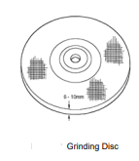
(f) Grinding/cutting discs
Grinding Disc
This grinding disc's thickness can vary from 6 mm to 10 mm.
It is glass-fiber reinforced and is approved for a maximum peripheral speed of 80 m/s. Grinding discs are used to grind away steel.

Slide 51
Grinding/cutting discs (p2)
Cutting Disc
Steel cutting disc
The disc must only be used for cutting steel. These discs are 2,5 - 3,5 mm thick and are glass fiber reinforced. It is approved for a maximum peripheral speed of 80 m/s
Concrete and non-ferrous metal (masonry) cutting discs.
This disc is only used for concrete and nonferrous metals. Like the steel cutting disc, it is also glass-fiber reinforced. It is also approved for a maximum peripheral speed of 80 m/s
Note:
The concrete and steel cutting discs look the same.
It is stipulated on the disc whether the disc is for cutting steel or concrete.
The non-ferrous metal cutting disc will have a specified code number

Slide 52
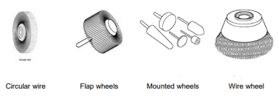
Grinding/cutting discs (p3)
Accessories
Rubber and fiber pads are used to support abrasive discs.
Polishing pads are used for polishing smooth surfaces.

Slide 53
(g) Impact wrench
The impact wrench has a regulator for adjusting to the bolt size.
Unfortunately, there's no indication on the regulator for specific torque settings.
To ensure safe tightening without over-torquing, start with a closed regulator, open it a quarter of the way, and tighten the bolt.
The trigger mechanism lacks a safety button like other pneumatic tools.
The trigger activates the rotor driving the square drive.

Slide 54
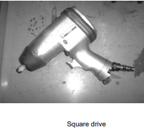
Impact wrench (p2)
Square Drive
Impact wrench square drives correspond to the wrench size (e.g., ½" drive for a ½" wrench).
Always use a heavy-duty socket to prevent cracking and rapid wear of ordinary sockets.
Attach the socket to the square drive using the spring-loaded clip on the square drive.

Slide 55
Impact wrench (p3)
Square Drive Application
Impact wrenches are specialized tools for assembly and maintenance, suitable for a wide range of bolts.
Industrial impact wrenches typically have a 0.75 kW motor, ±7000 rpm free speed, and torque up to 305Nm.
Choose the right impact wrench based on the specific sizes of bolts and nuts.

Slide 56
Impact wrench (p4) Square Drive Safety inspections
Use the right socket with the right drive.
Make sure that the socket is the right size for the bolt or nut.
Do not use worn or cracked sockets.
Do not repair damaged sockets but replace.
Always use heavy-duty sockets.
Wear personal protective equipment.

Slide 57
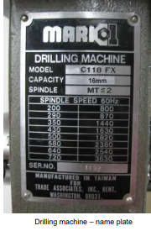
KT0103 Read and interpret the name plate on the power tools to identify the task related specifications
(a) Drilling machine
These machine nameplates provide six key details:
Manufacturer
Country of manufacture
Model number
Range of spindle speeds in RPM, Maximum drill bit size (e.g., 16mm), and
Taper size (e.g., Morse Taper MT#2).

Slide 58
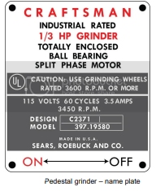
(b) Pedestal grinders
Grinding machine nameplate includes:
Manufacturer
Country of origin
Model number
Electric motor type
Electric current rating
Rotational speed in revolutions per minute (RPM)
Always use a grinding wheel with a rotational speed higher than the wheel manufacturer's rated speed, as per South African regulations.

Slide 59
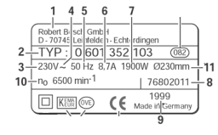
(c) Portable power tools – identification plate
Tool identification plate includes:
Manufacturer name or brand logo
Model part number
Voltage rating (V)
AC/DC – single phase/3 phase
Frequency rating (Hz)
Current rating (A)
Rated input (W)
Date of manufacture and serial number
Date of production
Nominal idling speed (RPM)
Max. disc diameter
The tool identification plate is the ID or passport of a power tool. It contains the technical data required to identify and characterize the appliance.

Slide 60
Portable power tools – identification plate (p2)
Tool identification plates, following safety regulations, include:
Name or trademark and manufacturer's origin
Manufacturer's model or trade name
Voltage rating (V)
Symbol for the type of current (e.g., F for alternating voltage)
Frequency rating (Hz)
Power rating (W)
Current rating (A)
Idling speed (for some tools)
Symbol for protection class II (for double-insulated power tools)
Marks of conformity, including the CE symbol, indicate compliance with European standards.

Slide 61
KT0104 Using the correct consumables as recommended by the manufacturer’s specification
The Occupational Health and Safety Act, 1993 requires reporting incidents related to machinery promptly.
Incidents include fracture or failure resulting in falling or flying objects, machinery running out of control due to control or safety equipment failure, and sudden release of pressurized gas.
Employers or users of machinery must report such incidents immediately to an inspector.

Slide 62
(a) Inspection of electric drills
Never use a faulty electric drill; check its condition before use.
If the drill is dangerous, take it out of service and report to the storekeeper.
Common faults include insulation damage on the power lead and faulty connections.
Ensure a three-core power lead and a 3-pin plug with proper color coding (live, neutral, earth).
Check for damaged or blocked air inlet and outlets to prevent motor damage.
Inspect casing for cracks or looseness.
Test switches; if in doubt, have them checked at the electrical shop or report to the storekeeper.
Bad earthing. This can cause electrocution 7. Cracked or broken insulation

Slide 63
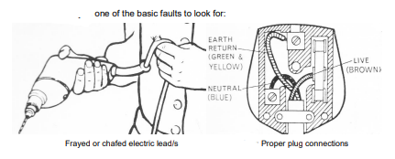
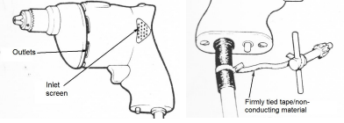

Inspection of electric drills (p2)

Slide 64
(b) Correct use of electric drills
Use the correct chuck key, secure it near the pistol grip with non-conductive material.
Grip and secure the drill before activating the trigger switch.
Lay down the drill deliberately and gently in a secure place.
Check the drill's voltage, securely fix the plug, and route the lead safely.
Ensure the drill is correctly located in the chuck and running before applying it to the workpiece.
Apply light pressure to avoid reducing the drill speed, especially at breakpoint.

Slide 65
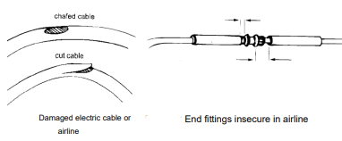
(c) Portable pneumatic drills
These tools fulfil the same function as the portable electric drills and are also available in various sizes.
They are generally regarded as safer tools than the electric drills as the motor is driven by air pressure.
A faulty pneumatic drill must never be used.

Slide 66
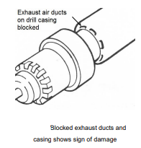
Portable pneumatic drills (p2)
Safe use of pneumatic or electric drills
The same rules apply for both electric and pneumatic drills. In the case of pneumatic tools – air pressure can be dangerous and should not be directed towards the body

Slide 67
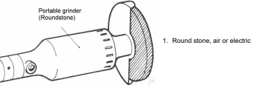
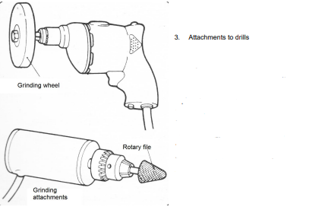
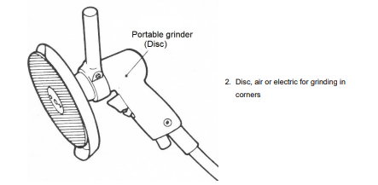
Portable pneumatic drills (p3)
Portable power-operated grinders
These may be pneumatic or electric. And are of the following types:

Slide 68
KM-07-KT02: Apply care and maintenance of engineering power tools.
After completing this topic, you the learner will be able to demonstrate an understanding of:
KT0201 Apply care and maintenance of engineering power tools.
KT0202 Service Power tools prior to commencement of the task descriptions
KT0203 Faulty power tools are identified, and corrective action recommended prior to the commencement of the task descriptions
KT0204 The understanding of the maintenance processes to accurately respond to the engineering power tools task related questions

Slide 69

KT0201 Apply care and maintenance of engineering power tools.
(a) Pedestal grinder - Abrasive wheels Maintenance
Handle wheels with care always - they break easily.
Do not grind on sides or corners of wheel unless it is impossible to grind the job at hand on the face of the wheel. This rule should be observed because it is difficult to dress the sides of the wheel.

Slide 70
Pedestal grinder - Abrasive wheels (p2)
When mounting wheel on spindle observe the following precautions:
Tap the wheel with a cellulose or rubber hammer to test it. A ringing sound is good, a dull thud indicates a cracked wheel—do not use a cracked wheel.
Ensure the wheel has blotter paper gaskets or safety washers on each side. If using washers, remove the paper and fit rubber sides next to the wheel.
Do not force the wheel onto the spindle; it should slide on easily with a 0.003-to 0.005-inch clearance.
Tighten the spindle nut only enough for the flanges to hold the wheel firmly—overtightening may crack the wheel.
After installation, start the wheel and test for breakage.

Slide 71
Pedestal grinder - Abrasive wheels (p3)
For grinding machines, use a diamond dressing tool in a fixed tool post for these operations.
Set the tool almost in contact with the high point of the wheel.
Start the wheel and traverse the tool, feeding into the wheel 0.001 to 0.002 inches at the end of each pass.
Move the cutter back and forth across the wheel face using a 0.001-inch feed until the sound indicates the dresser is cutting all around the wheel.

Slide 72
Pedestal grinder - Abrasive wheels (p4)
Adjust the tool rest to align the wheel dresser with the centerline of the abrasive wheel.
Start the wheel and support the dresser on the tool rest with the handle tilted upward.
Slowly press the dresser against the revolving wheel until it bites, then move it from side to side for a straight surface. Caution: Hold the dresser rigidly to prevent vibration.
Smooth the wheel by passing an abrasive-type dresser back and forth over the wheel face with very light pressure.

Slide 73

Pedestal grinder - Abrasive wheels (p5)

Slide 74
Pedestal grinder - Abrasive wheels (p5)
Common Misuses and Abuses
Do not use a worn wheel at the same RPM as when new. This causes excessive softness and fast wear due to reduced grinding surface speed.
Increase RPM to compensate for the smaller size. Stow unused wheels properly.
Never attempt to enlarge a likely to break or bend the or reamer to enlarge hole.
Do not allow drills to overheat while in use or being sharpened.
do not use a steel hammer or other hard object. This would damage cutting edges.
Do not place work-supporting blocks far from drill. "Springiness" of work will snap off drill. Support work near drill and clamp securely to prevent turning.

Slide 75




Pedestal grinder - Abrasive wheels (p6)

Slide 76
KT0202 Service Power tools prior to commencement of the task descriptions
(a) Service schedule for Pedestal grinder includes evaluating if:
Grinding wheel/s are not cracked/ring tested.
Grinding wheel running true.
Grinding wheel face dressed/not clogged.
Gap between tool rest and wheel face (min 3mm)? Includes secure fastening of tool rest.
Grinding wheel speed rating (RPM) is higher than the rated speed of machine.
Wheel guards are secure, and bolts tightened.
Eye protection screen is clear of scratching and secure.
Safety signage is mounted and in full view of operator.
On/off switch in good condition.
Isolator switch at mains is present/good condition.
Sufficient coolant in trough.
General state of machine is satisfactory.

Slide 77
(b) Service schedule - Drilling machine (fixed/mounted)
Evaluating if:
Drill spindle in good condition and running true.
Spindle taper is clearly marked (eg.MT#2).
Drill drift safely attached to machine pillar/column.
Chuck key safely attached to machine casing.
Drill speed adjustment (RPM) can be safely adjusted – with all levers serviceable.
Protective guards are secure, and bolts tightened at spindle head.
Eye protection screen is clear of scratching and secure.
Safety signage is mounted and in full view of operator.
On/off switch in good condition? 10 Isolator switch at mains is present/good condition.
Machine table is free of dirt and easy to adjust.
Machine vice is serviceable and fastening bolts and washers are in satisfactory condition.
General state of machine is satisfactory.
Adequate fastening set wrenches are located at the machine

Slide 78
KT0202 Faulty power tools are identified and corrective action taken.
(a) Service checks for a portable drilling machine includes evaluating if:
All electric leads clear of cuts/chafing and are secure at entry to machine casing.
Machine casing is in satisfactory condition/no risk to operator.
Chuck key safely attached to machine casing.
Air inlet vents are not blocked/allows clear passage of air.
Exhaust vents are clear and not blocked.
On/off switch in good condition.
General state of machine is satisfactory.
3-Pin plug at wall socket is secure/poses no risk of electric shock and is sufficiently grounded.
Speed settings are possible and are functional.
Mode settings – “hammer” mode to “regular” speeds – and reverse direction (where applicable) - are possible

Slide 79
KT0204 Use the correct consumables as per manufacturer specification
Service schedule – Angle grinder (Electrical and Pneumatic):
All electric leads clear of cuts/chafing and are secure at entry to machine casing.
Machine casing is in satisfactory condition/no risk to operator.
2-Pin spanner/wrench is safely attached to machine casing or stored in a convenient place.
Air inlet vents are not blocked/allows clear passage of air 5 Exhaust vents are clear and not blocked.
On/off switch in good condition and safety button/mechanism in switch is fully functional.
General state of machine is satisfactory.
3-Pin plug at wall socket is secure/poses no risk of electric shock and is sufficiently grounded.
Machine guards for grinding disc is secure and two-handed grip is possible.
Cut-off saw is mounted securely

Slide 80
KM-07-KT03: Store engineering power tools in a safely designated area
After completing this topic, you the learner will be able to demonstrate an understanding of:
KT0301 Engineering power tools are stored as per storage management specifications
KT0302 Safely store different engineering power tools orderly according to their classifications
KT0303 Store engineering power tools in a lock up safely designated area
KT0304 Procedures for storing different engineering power tools must be maintained
KT0305 Safety inspection and records of stored engineering power tools are administered
KT0306 Recognize and report problems, changes and/or malfunctions while storing engineering power tools

Slide 81
KT0301 Engineering power tools are stored as per storage management specifications
Efficient material handling, including crane operations, truck driving, manual carrying, and pallet stacking, is crucial for industry.
It ensures a continuous flow of tools, equipment, and parts, preventing delays. Improper handling can lead to costly injuries.
For safe storage of power tools, emphasize general safety principles, proper work practices, and equipment controls.
Ensure employees are aware of potential hazards and know how to minimize risks when moving materials manually or mechanically.

Slide 82
KT0302 Safely store different power tools according to their classifications
Efficiently handling and storing materials, from hoisting steel with a crane to stacking palletized items, is crucial for industry.
It ensures a continuous flow of tools, equipment, and parts through the workplace, maintaining availability when needed. Improper handling can lead to costly injuries.
For safe power tool storage, prioritize training, and adhere to general safety principles, work practices, and equipment controls.
Regular workplace examinations help detect and address unsafe conditions promptly.

Slide 83
KT0303 Store engineering power tools in a lock up safely designated area
Establishing a safe designated area involves:
Providing a dedicated storeroom for tools, equipment, and consumables.
Outfitting the storeroom with suitable shelving and fixtures for safe storage and distribution.
Staffing the store with qualified personnel trained in storekeeping.
Implementing an administration system to document tool transactions.
Establishing a company policy for new purchases, equipment control, decommissioning, and re-issuance.

Slide 84
KT0304 Procedures for storing different power tools
Proper storage for power tools is crucial for:
Accessibility: Efficient access to welding tools minimizes time wastage.
Theft Prevention: Implementing secure storekeeping safeguards tools and equipment.
Classification: Adopting a systematic storage approach organizes tools by groups for easy identification. Example groups include striking tools (e.g., hammers), deburring tools (e.g., hand files), abrasive tools (e.g., emery paper), and power tools, each requiring specialized storage arrangements

Slide 85


Proper storage for power tools (p2)

Slide 86
Proper storage for power tools (p3)
Storekeeping procedures:
Staffing -Dedicated personnel responsible for:
Recording tools issued and outstanding.
Ensuring safe storage and use of tools.
Maintaining tools, arranging repairs, and calibrating machinery.
Identifying the need for replacements and reordering.
Conducting regular stocktaking to monitor losses.
Collaborating with sales representatives for replacement quotations.

Slide 87

KT0305 Safety inspection and records of stored engineering power tools are administered
Maintenance Work Scheduling and Power Tool Records:
Scheduling Repairs:
Large repairs reported during routine servicing.
Jobs rescheduled based on reports and manufacturer's instructions.
Power Tool Records:
Follow manufacturer's servicing instructions.
Maintain records of all repairs performed.
Use records for future maintenance planning and suitability assessments.
Administration Information for Safety:
Applications of various power tools.
Common faults and defects.
Marking procedures for unsafe tools.
Routine maintenance requirements and storage locations.
Hazards and risks associated with different power tools.
Application of personal protective equipment (PPE).

Slide 88

KT0306 Recognize and report problems, changes and/or malfunctions while storing engineering power tools
Store Procedure Application:
General Store Usage:
Store keeps necessary workshop items to prevent delays.
Stock levels depend on usage frequency and value.
Expensive and rarely needed parts are not stocked.
Parts Store:
Stock quantity based on usage rate and value.
Avoid stocking expensive and rarely used parts.
Tool Stores:
Loan only special tools and power tool parts (drills, grinders).
Return power tools to the store in good condition.
Obtaining Required Items:
Use correct names for parts when requesting.
Fill in a requisition for replacement parts.
Sign for special tools and return promptly.

Slide 89

The End

